Slide 1
Using Bitbake to Generate an Embedded RISCV Linux Distribution
RV64B Reporter：胡亦旻
组员：沈科杰 徐品

Slide 2
Three Instruction to Run the system
source oe-init-build-env
bitbake core-image-riscv
runqemu qemuriscv64 nographic slirp

Slide 3
What Can Bitbake Help Us?
Cross-complie
Dependency
Package Management
Image Generation
Flexibility
Reusability

Slide 4
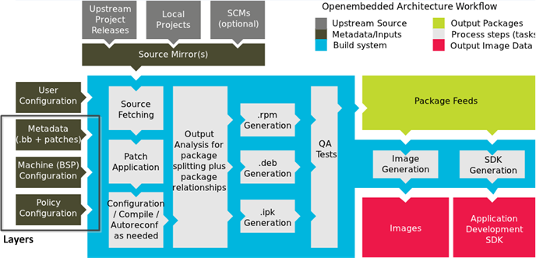
Bitbake Structure

Slide 5
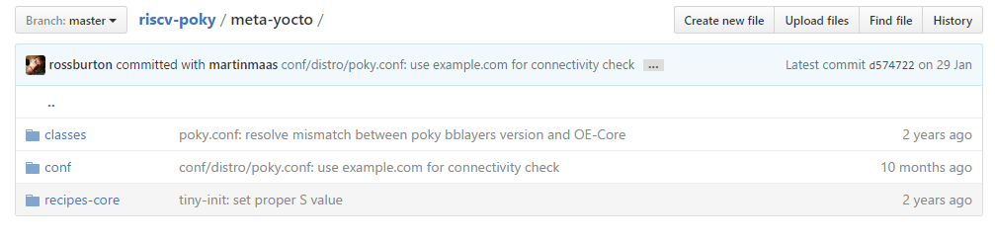
Typical Structure of Layers
classes
conf
recipe-*

Slide 6
Classes
autotools.bbclass: define the default operation to packages using autotools to make & install
base.bbclass: all recipe & class inherit base.bbclass
https://github.com/riscv/riscv-poky/blob/master/meta/classes/base.bbclass

Slide 7
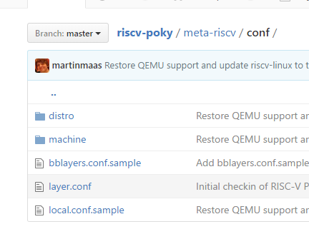
Configuration: User & Layer
Global: bblayer.conf, local.conf
Layers: distro.conf, machine.conf, layer.conf

Slide 8
Recipe
.bb file: define how to deal with a specific package
https://github.com/DynamicDevices/meta-example/blob/master/recipes-example/bbexample/bbexample_1.0.bb

Slide 9
Bitbake build procedure
mostly defined in base.bbclass
Fetch source using SRC_URI & unpack
do_patch
do_configure, do_compile, do_install

Slide 10
Deal with packages
In our case, using rpm to manage packages
Bitbake: do_package, do_packagedata: save rpms in tmp/deploy/rpm

Slide 11
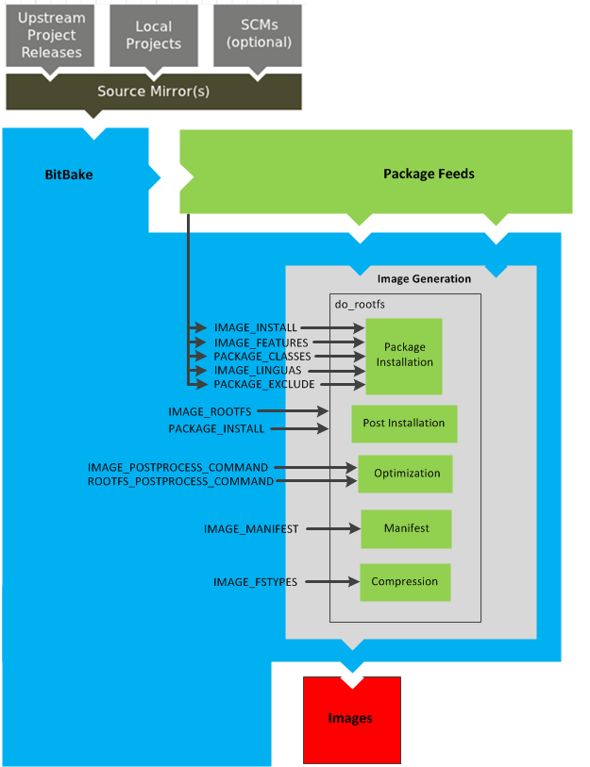
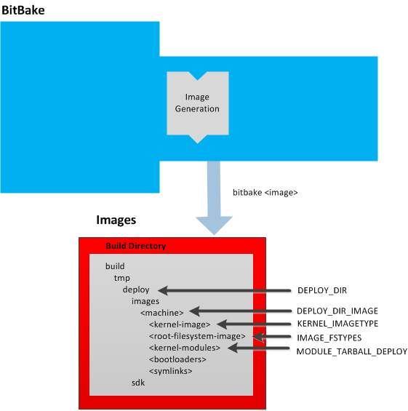
Generate Image
do_rootfs
make rootfs a cpio.gz
make a ext2 filesystem

Slide 12
Pseudo(Fake Root)*?
How to deal with uid, gid?

Slide 13
Back to that three instruction
source oe-init-build-env: setting environment variables and construct a basically project for later work
bitbake core-image-riscv: we have a recipe called core-image-riscv.bb, and that is our target and finally we have images we need
runqemu qemuriscv64 nographic slirp:
./scripts/runqemu parse qemuriscv64 as a parameter, and search deploy/images to find appropriate images for booting.

Slide 14
Adding a New Software to the machine
Using a official example bbexample
Target: to run bbexample and see helloworld in virtual machine(by adding a new layer)
Keypoints:1. bblayers.conf 2. bitbake bbexample 3.local.conf

Slide 15
Show the RISCV Linux distribution with added package

Slide 16
Thanks for you attention!
Contact:huyimin@pku.edu.cn

